Slide 1
Database Management System Data Models
Dr. T. JOSHVA DEVADAS
Associate Professor Senior
SJT Annex- 103 F
Joshvadevadas.t@vit.ac.in

Slide 2
Data Models Outline

Slide 3
Data Models, Schemas, and Instances
Three Schema Architecture
Data independence
Database System Environment
Component modules of a DBMS and their interactions
DBMS Architecture
2-tier and 3-tier architecture
Centralized and Client-Server DBMS Architectures
2-Tier and 3-Tier Client-Server Architecture
A Physical Centralized Architecture
Classification of Database Management Systems

Slide 4
Data Models
A data model is the collection of concepts that can be used to describe the structure of the database.
It is a pictorial representation of Tables.
Represents relationship between Tables.
The data model is defined as conceptual, physical and logical levels.
It also helps to define the relational tables, primary and foreign keys.

Slide 5
Categories of Data Model
Conceptual / High Level
What the system contains. Also called entity-based or object-based data models
Physical / Low Level
How the system will be implemented on DBMS.
Provide concepts that describe details of how data is stored in the computer. These are usually specified in an ad-hoc manner through DBMS design and administration manuals.
Representational or Implementation
e.g. relational data models used in many commercial systems
Logical
How the system should be implemented.

Slide 6
Conceptual Model
A conceptual data model identifies the highest-level relationships between the different entities.
The basic three element of this model is
Entity
Attribute
Relationship

Slide 7
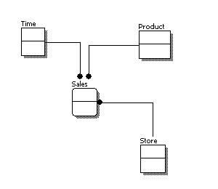

Slide 8
Physical Data Model
It represents how the model will be built in the database.
It shows all table structures, including column name, column data type, column constraints, primary key, foreign key, and relationships between tables.

Slide 9
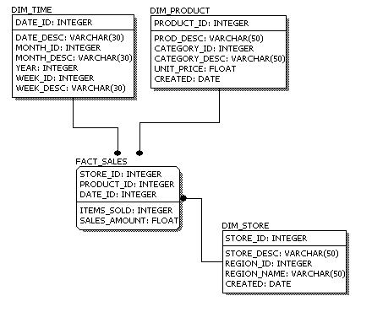

Slide 10
Logical Data Model
It defines the structure of the data elements and set the relationships between them.
It describes the data in as much detail as possible, without regard to how they will be physically implemented in the database.
Features of a logical data model include:
Includes all entities and relationships among them.
All attributes for each entity are specified.
The primary key for each entity is specified.
Foreign keys (keys identifying the relationship between different entities) are specified.
Normalization occurs at this level.

Slide 11
Steps for designing the logical data model
Specify primary keys for all entities.
Find the relationships between different entities.
Find all attributes for each entity.
Resolve many-to-many relationships.
Normalization.

Slide 12
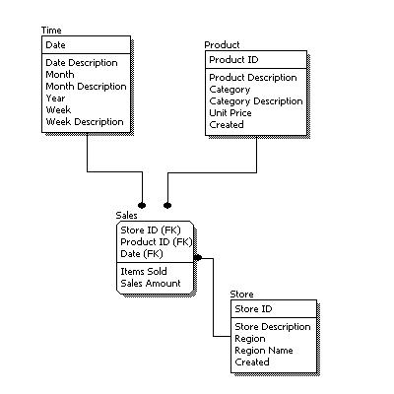

Slide 13
Data Model
Hierarchical Model
It is a tree like structure.
The child has only one parent.
One to many relationship.
Network Model
It is a graph like structure.
The child may have one or more parents.
It uses many to many data relations.
Entities Relationship Model
Relational Model
Object-based data models (Object-oriented and Object-relational)
Semi-structured data model (XML)

Slide 14
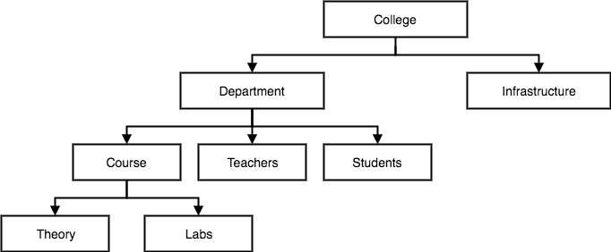
Hierarchical Model

Slide 15
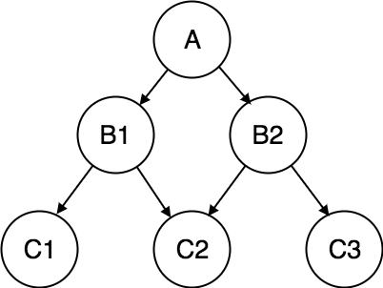
Network Model

Slide 16
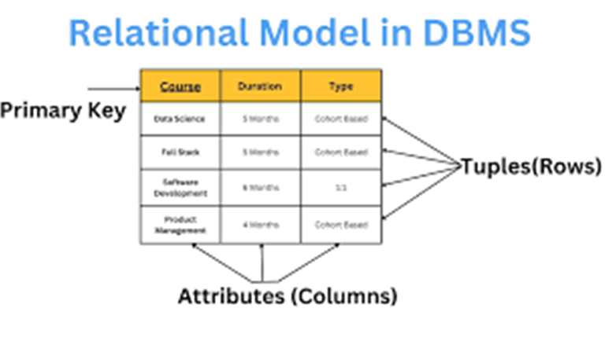
Relational Model

Slide 17
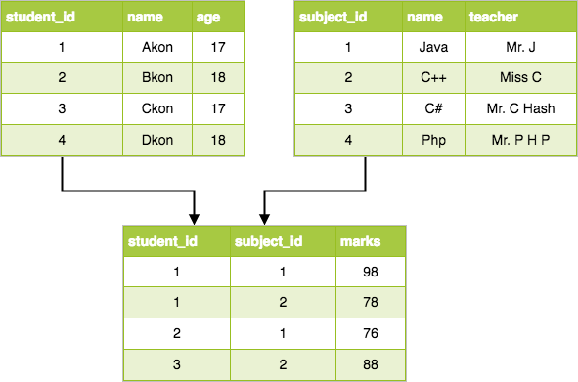
Relational Model

Slide 18
Schema
The logical structure of the database
Analogous to type information of a variable in a program
Physical schema: database design at the physical level
Logical schema: database design at the logical level

Slide 20
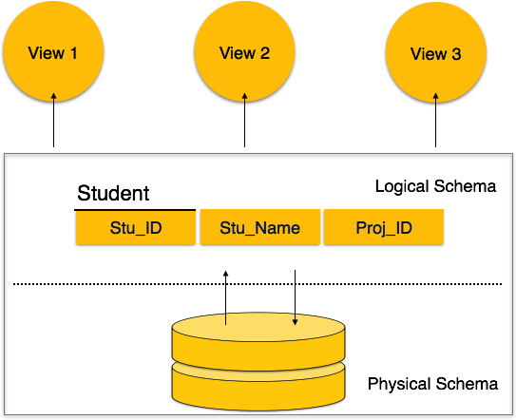

Slide 21
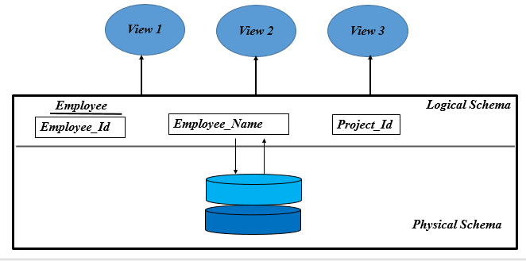

Slide 22
Instance
The actual content of the database at a particular point in time
Database State:
Empty State
At the time of defining the database
Initial State
When database is first time loaded
Current State
Working stage

Slide 23
Three Schema Architecture
There are three basic characteristics of DBMS
Self describing
Insulation of program and data
Support multiple user views
The main objective of this architecture to separate the user application from physical database.
Three-schema architecture
incorporates these characteristics into a DB
separates application program from physical database
provides users with different levels of data abstraction

Slide 24
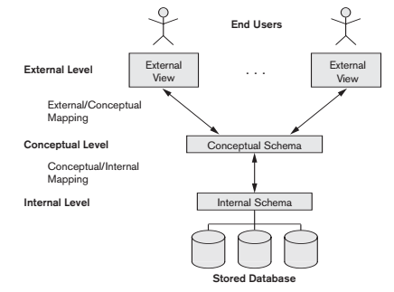
Three Schema Architecture
Notes:
Internal level: it describe the physical structure of the database. It uses the physical data model and describes the complete details of data storage and access path for the database.
Conceptual schema: The conceptual schema hides the details of physical storage structures and concentrates on describing entities, data types, relationships, user operations, and constraints. Usually, a representational data model is used to describe the conceptual schema when a database system is implemented.
External view: Each external schema describes the part of the database that a particular user group is interested in and hides the rest of the database from that user group. As in the previous level, each external schema is typically implemented using a representational data model, possibly based on an external schema design in a high-level data model.

Slide 25
Three Schema Architecture
Defines DBMS schemas at three levels:
Internal schema at the internal level to describe physical storage structures and access paths (e.g indexes).
Typically uses a physical data model.
Conceptual schema at the conceptual level to describe the structure and constraints for the whole database for a community of users.
Uses a conceptual or an implementation data model.
External schemas at the external level to describe the various user views.
Usually uses the same data model as the conceptual schema

Slide 26
Three Schema Architecture
Mappings among schema levels are needed to transform requests and data.
Programs refer to an external schema, and are mapped by the DBMS to the internal schema for execution.
Data extracted from the internal DBMS level is reformatted to match the user’s external view (e.g. formatting the results of an SQL query for display in a Web page)

Slide 27
Data independence
Logical Data Independence: the ability to modify the conceptual schema without having to change external schema.
Physical Data Independence – the ability to modify the physical schema without changing the logical schema
Applications depend on the logical schema
In general, the interfaces between the various levels and components should be well defined so that changes in some parts do not seriously influence others.

Slide 28
Data independence …
When a schema at a lower level is changed, only the mappings between this schema and higher-level schemas need to be changed in a DBMS that fully supports data independence.
The higher-level schemas themselves are unchanged.
Hence, the application programs need not be changed since they refer to the external schemas.

Slide 29
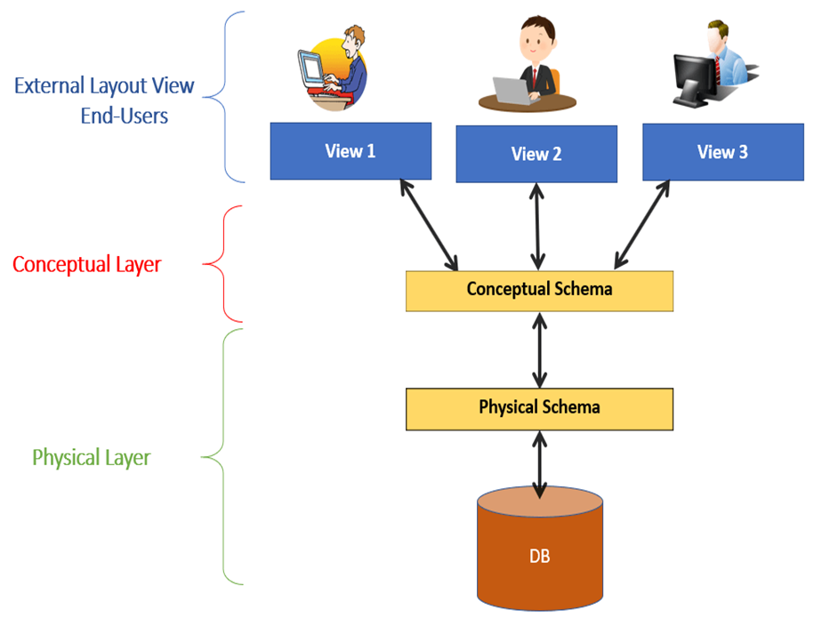

Slide 30
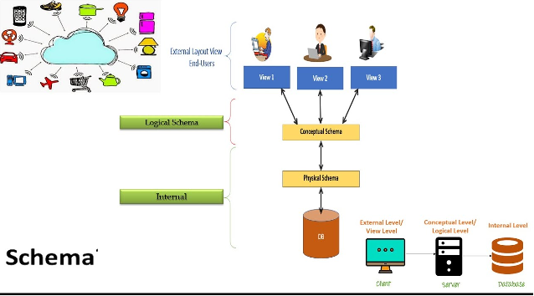

Slide 31
Database System Environment
DBMS software + OS +
Compiler of programming (host) language
= Database system environment

Slide 32
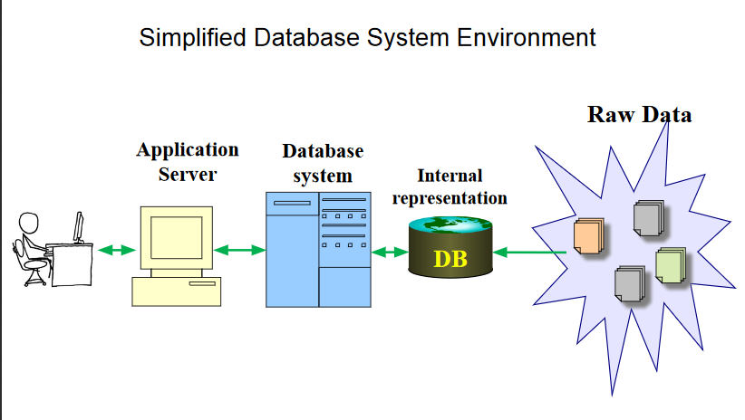

Slide 33
Computational Model of DBMS Component modules of a DBMS and their interactions

Slide 34
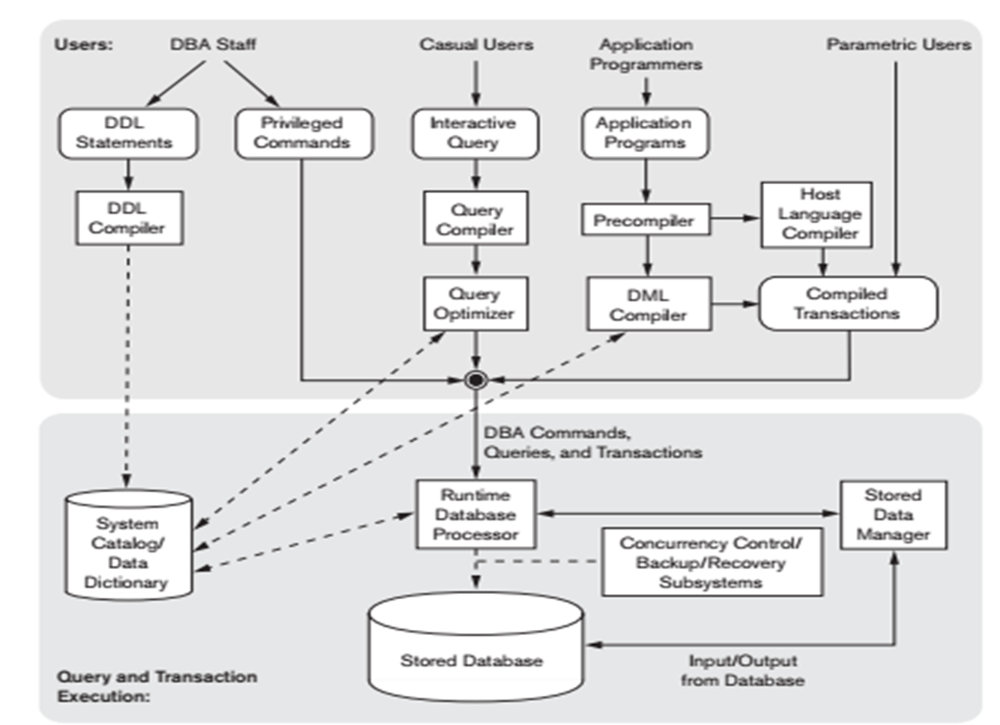

Slide 35
Components of DBMS Software
DDL compiler processes schema definitions & stores descriptions of the schemas (meta-data) in the DBMS catalog.
Query compiler parses a query, validates its correct syntax, name of files, data elements & converts it into internal form.
Query optimizer removes redundancy from query, rearranges operations, generates execution plan, selects the optimal execution plan, generates executable code & calls runtime database processor.

Slide 36
Components of DBMS Software
Pre-compiler extracts embedded DML statements from application program.
DML compiler compiles DML statement and converts it into object code.
Runtime database processor executes
(a) privileged commands
(b) executable query plan
(c) canned transactions with runtime parameters
(d) backup, recovery & concurrency control
Stored data manager controls access to data & meta-data.

Slide 37
Database system utilities
Most DBMS also has database utilities (apart from modules).
Utilities facilitate DBA to manage database system
Loading
to load existing data files into the database.
Conversion tool to transfer data from one DBMS into another.
Backup
to create a backup copy of the database.
(Dump the entire database into tape or other mass storage medium, or incremental backup)

Slide 38
Database system utilities
Database storage reorganization
to improve performance of a database by reorganizing database files in different organization and creating indexes.
Performance monitoring tool
Monitors usage of the database and provides statistics to the DBA.
The DBA uses these statistics to decide whether to reorganize the database files, whether to create index so as to improve performance of the database system.

Slide 39
Database system utilities
Other utilities
Sorting files, data compression, monitoring access by users.

Slide 40
DBMS Architecture
1-tier Architecture:
The database is directly available to the user for storing and retrieving the data.
Client, server, and the Database are all present on the same machine
2-tier Architecture:
End user does not access the database directly.
Database can access through Application Program Interface to establish interaction via third party service like ODBC, JDBC.
The application at the client end directly communicates with the database at the server side.
On the client side, the user interfaces and application programs are run.
The application on the client side establishes a connection with the server side in order to communicate with the DBMS.
Desktop application is a good example of 2-tier architecture.

Slide 41
3-tier Architecture:
There is another layer between the client and the server.
Client does not communicate directly to the server. Instead, it interacts with an application server which further communicates with the database system and then the query processing and transaction management takes place.
A layer present between client and server that manage the query processing and transaction management.
The web based application is one of the example of 3-tier architecture.
N-tier Architecture:
It provides a client server architecture.
It has separate presentation, processing and data management functions.

Slide 42
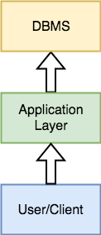
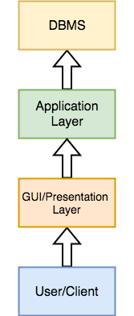
2-tier and 3-tier architecture

Slide 43
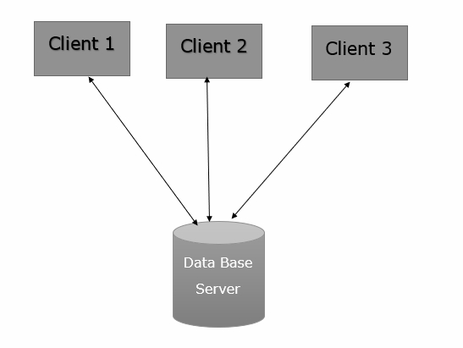
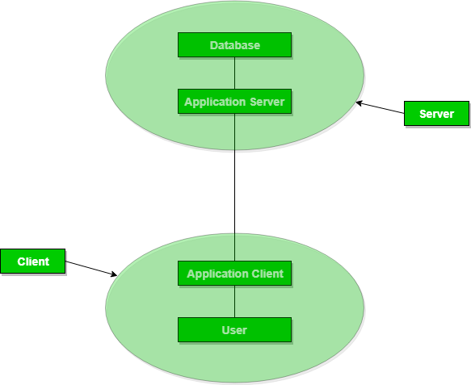
2-Tier Architecture 3-Tier Architecture

Slide 44
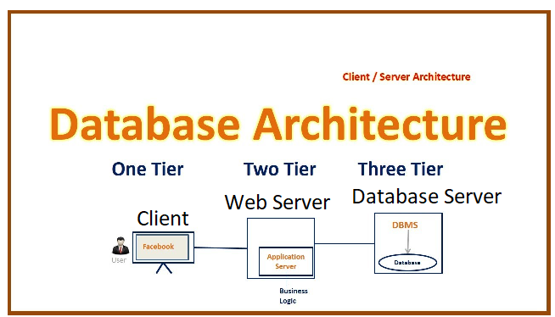

Slide 45
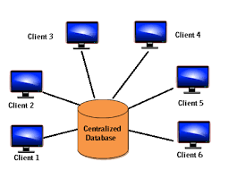
Centralized and Client-Server DBMS Architectures
Centralized DBMS:
Combines everything into single system including- DBMS software, hardware, application programs, and user interface processing software.
User can still connect through a remote terminal – however, all processing is done at centralized site.

Slide 46
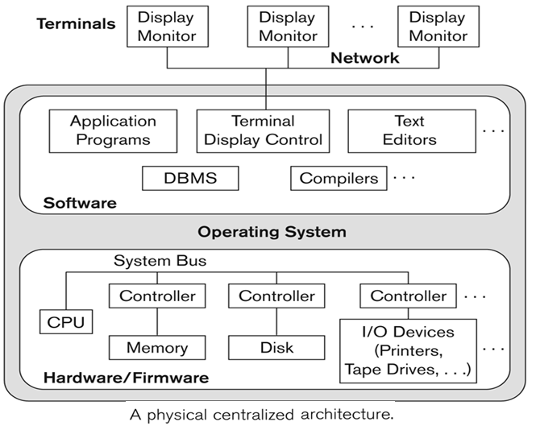
A Physical Centralized Architecture

Slide 47
Basic 2-tier Client-Server Architectures
Specialized Servers with Specialized functions
Print server
File server
DBMS server
Web server
Email server
Clients can access the specialized servers as needed

Slide 48
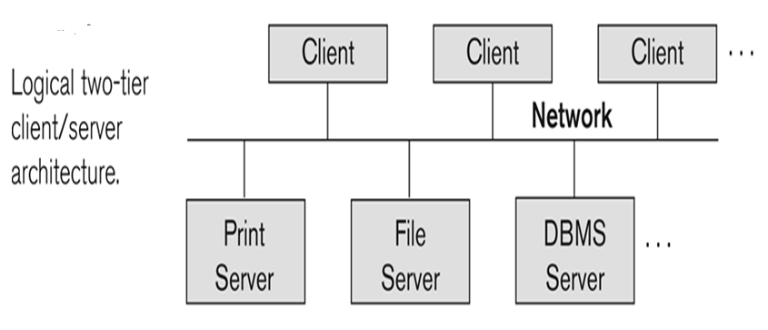
Logical two-tier client server architecture

Slide 49
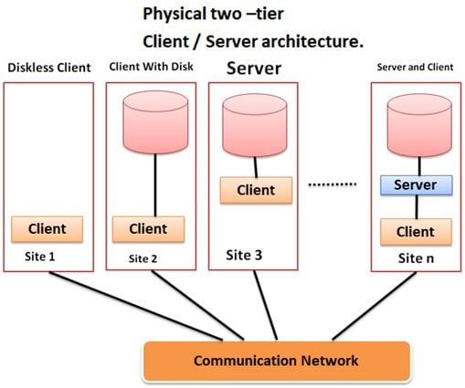

Slide 50
Client
Provide appropriate interfaces through a client software module to access and utilize the various server resources.
Clients may be diskless machines or PCs or Workstations with disks with only the client software installed.
Connected to the servers via some form of a network.
(LAN: local area network, wireless network, etc.)

Slide 51
DBMS Server
Provides database query and transaction services to the clients
Relational DBMS servers are often called SQL servers, query servers, or transaction servers
Applications running on clients utilize an Application Program Interface (API) to access server databases via standard interface such as:
ODBC: Open Database Connectivity standard
JDBC: for Java programming access
Client and server must install appropriate client module and server module software for ODBC or JDBC.

Slide 52
Two Tier Client-Server Architecture
A client program may connect to several DBMSs, sometimes called the data sources.
In general, data sources can be files or other non-DBMS software that manages data.
Other variations of clients are possible: e.g., in some object DBMSs, more functionality is transferred to clients including data dictionary functions, optimization and recovery across multiple servers, etc.

Slide 53
Three Tier Client-Server Architecture
Common for Web applications
Intermediate Layer called Application Server or Web Server:
Stores the web connectivity software and the business logic part of the application used to access the corresponding data from the database server
Acts like a conduit for sending partially processed data between the database server and the client.
Three-tier Architecture Can Enhance Security:
Database server only accessible via middle tier
Clients cannot directly access database server

Slide 54
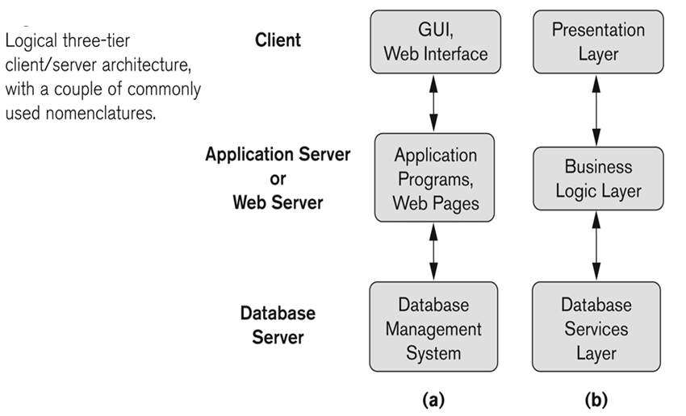
Three-tier client-server architecture

Slide 55
Classification of Database Management Systems
1) Classification based on data model
RDBMS, OODBMS (based on object model), Many legacy applications still run on database systems based on the hierarchical and network data
models.
2) Number of users at a time
a) Single-user DBMS – support one user at a time
b) Multi user DBMS – multiple user can access the database simultaneously

Slide 56
Classification of Database Management System…
3) Number of sites over which the database is distributed.
a) Centralized DBMS– Database stored in a single computer.
b) Distributed DBMS – database and DBMS software distributed over many sites, connected by a computer network.
Homogeneous DDBMS (Same DBMS at all sites)
Heterogeneous DDBMS (Different DBMS at different sites).
Federated DBS/Multi database system = DDBMS
+ heterogeneous DBMS + participating sites with local autonomy.

Slide 57
Classification of Database Management System…
4) Special-purpose & general-purpose
Airline reservation system, telephone directory system → special- purpose DBMS
5) Cost
It is difficult to propose a classification of DBMSs based on cost.
Today we have open source (free) DBMS products like MySQL and PostgreSQL that are supported by third-party vendors with additional services.

Slide 58
Classification of Database Management System…
The giant systems are being sold in modular form with components to handle distribution, replication, parallel processing, mobile capability, and so on, and with a large number of parameters that must be defined for the configuration.
Furthermore, they are sold in the form of licenses –
site licenses allow unlimited use of the database system with any number of copies running at the customer site.
Another type of license limits the number of concurrent users.
Standalone single user versions of some systems like Microsoft Access are sold per copy or included in the overall configuration of a desktop or laptop.

Slide 59
Cost considerations for DBMSs
Cost Range: from free open-source systems to configurations costing millions of dollars
Examples of free relational DBMSs: MySQL, PostgreSQL, others
Commercial DBMS offer additional specialized modules, e.g. time-series module, spatial data module, document module, XML module
These offer additional specialized functionality when purchased separately
Sometimes called cartridges (e.g., in Oracle) or blades
Different licensing options: site license, maximum number of concurrent users (seat license), single user, etc.

